Slide 1
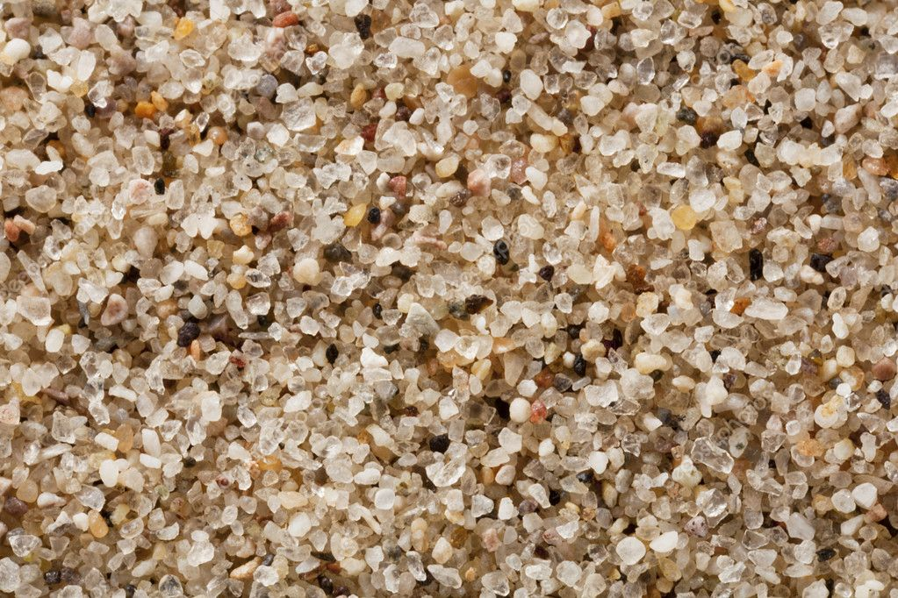
Grain Size Analysis Using
Machine Learning

Slide 2

Contribution
Bogineni Krishna Satya Sai Ram — Visualization and pixel size calculation, Utilizing Gray Level Co-occurrence Matrix and report
Nayudu Ravindranath Chowdary — Multi-stage processing and outline filtering, ImageJ.Js execution and Integration of image preprocessing
3.The world map showcasing energy consumption distribution exposes disparities in energy demand, signifying the need for energy conservation and equitable access to energy resources.

Slide 3

AGENDA
01
02
03
Aim
Abstract
Introduction
04
05
06
System Requrements
Image
Processing
Boundaries Detection
07
08
09
04
Mean Grain Size
Applications
Results & Discussion

Slide 4
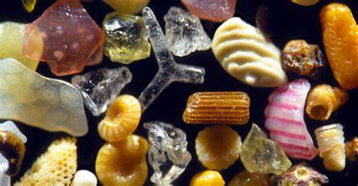
AIM
This project aims to develop an advanced image processing system for precise microscopic particle characterization in grain images. Using innovative techniques, we aim to enhance particle visibility, implement precision cropping, and employ sharpening kernels for accurate segmentation. Our multidisciplinary approach includes particle size distribution and a novel texture analysis method based on Gray Level Co-occurrence Matrix (GLCM) features. By integrating theory with practical code implementations, our goal is to offer a robust methodology for detailed particle analysis and contribute valuable insights to the field of microscopic image processing.
d

Slide 5

Abstract
This work provides a complicated image processing and analysis approach for the categorization of particles in microscope photographs. The recommended procedure combines editing, multi-stage processing, and photo file alteration to increase particle exposure. Particle segmentation and outline filtering procedures are employed to obtain significant features, and then a detailed analysis of particle sizes, locations, and aspect ratios is done,while a unique texture analysis using Gray Level Co-occurrence Matrix (GLCM) enhances understanding of particle composition. The technique, including K-Means labeling and contour analysis, offers a valuable framework for particle identification, applicable in biology, material science, and environmental monitoring.

Slide 6
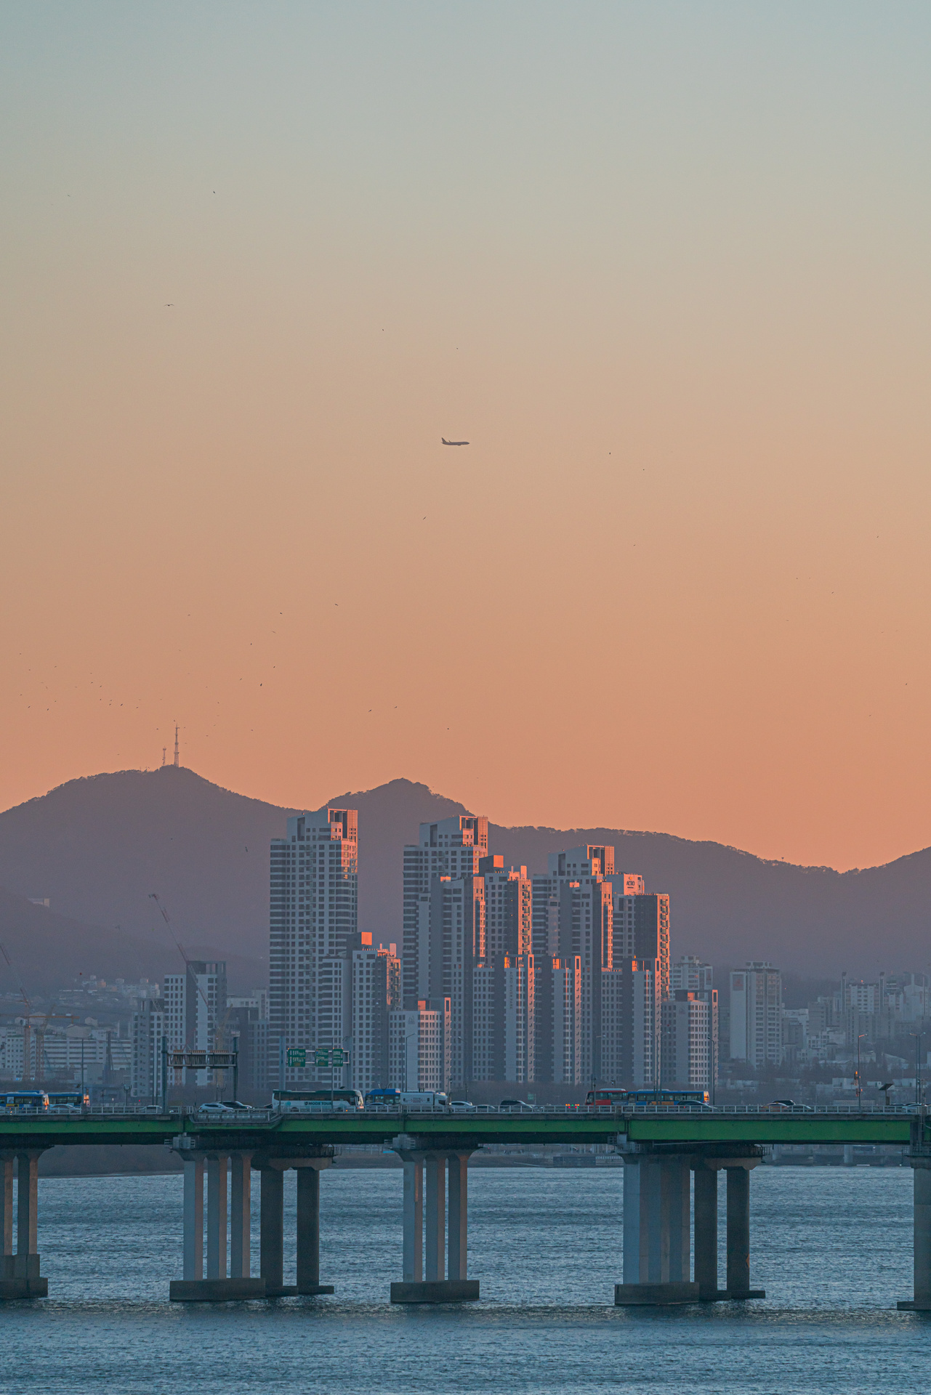
Introduction
This project delves into the realm of microscopic images to gain crucial insights into the composition and structure of minute particles. The rapid advancements in imaging technology have resulted in an abundance of high-definition photos, prompting the need for innovative approaches to image processing and analysis for effective interpretation. Our enhanced approach involves a systematic process, encompassing format conversion, trimming, and precision cropping to establish a focused study area. The project's future components entail a multi-stage image processing pipeline, incorporating methods like contrast enhancement and sparingly applied sharpening kernels to improve particle visibility and segmentation. A multidisciplinary approach is adopted to consider various particle attributes, including size, orientation, and aspect ratio. Innovative technologies, such as three-dimensional scatter plots, are employed to showcase particle size distribution. Additionally, a novel texture analysis using Gray Level Co-occurrence Matrix features is presented, offering a clearer understanding of even the subtlest textural changes between particles. The project's comprehensive nature is further emphasized through a detailed literature review, integration of theoretical principles with practical code implementations, and a thorough analysis of particle characteristics in the results and discussion section. The noteworthy findings are summarized in the concluding chapter, "Conclusion and Future Research," which also provides recommendations for further study.

Slide 7

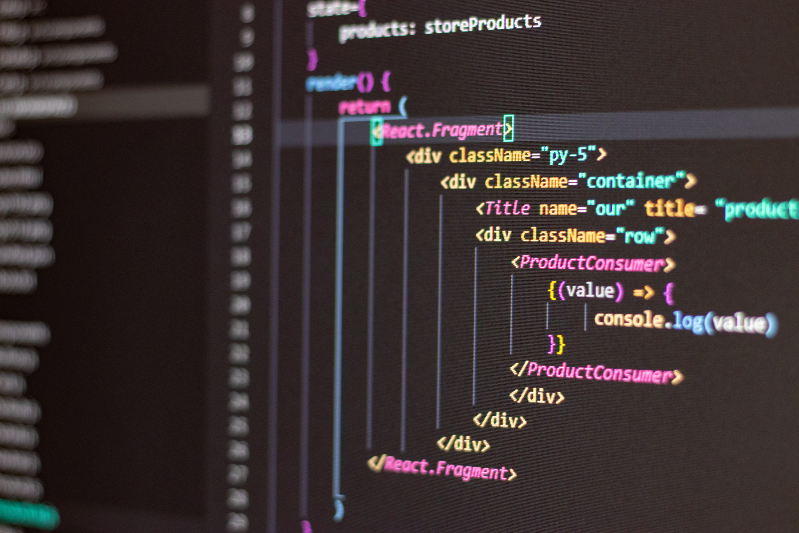
System Requirements
Hardware requirements:
8GB RAM
256 or above ssd
Multicore Processor
Preinstalled OS(Windows, macOS, or Linux).
Software requirements:
An IDE such as Jupyter Notebook or Visual Studio Code is recommended
Python 3.x, along with data analysis libraries like Pandas, NumPy, Matplotlib, and Seaborn are necessary
windows XL or any other prefered apps for data sets
ImageJ.JS Tool for size detection anaysis

Slide 8
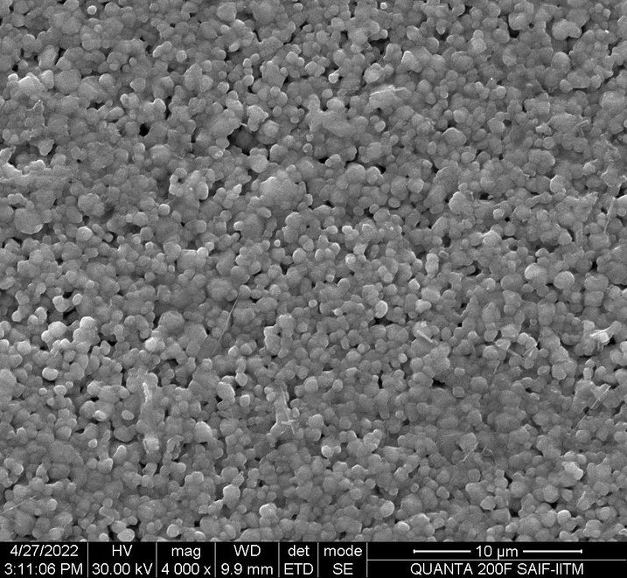
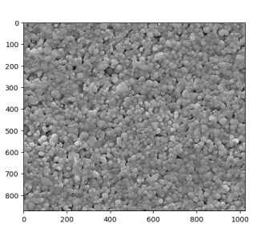
Image Processing
1. Load TIFF and Convert to JPEG:
- Open a TIFF image, convert it to JPEG, and save the result.
2. Open, Crop, and Save JPEG Image:
- Open a JPEG image, crop it to specified dimensions, and overwrite the original file.
3. Adjust Brightness and Contrast:
- Apply brightness and contrast adjustments to an image using OpenCV, and visualize the result.
4. Create and Apply Sharpening Kernel:
- Define a sharpening kernel, apply it to an image using OpenCV, and display the sharpened result.
5. Show Images and Visualization:
- Use Matplotlib to display the original adjusted image and the final sharpened image. Note the potential overwrite issue in saving the cropped image.

Slide 9
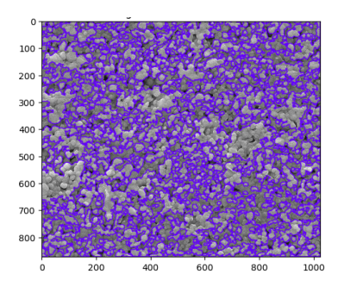
Boundaries Detection
1. Grayscale Conversion and Gaussian Blur:
- Convert the cropped image to grayscale and apply Gaussian blur for noise reduction.
2. Particle Segmentation with Thresholding:
- Use thresholding to segment particles in the blurred grayscale image.
3. Contour Detection and Particle Diameter Calculation:
- Find contours in the thresholded image, calculate particle diameters, and store them.
4. Draw Particle Boundaries and Display Result:
- Draw particle boundaries on the original cropped image, calculate and print the average diameter, and display the modified image with Matplotlib.

Slide 10
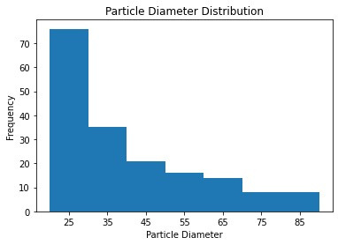
Mean Grain Size
1. Round and Sort Particle Diameters:
- Round each particle diameter to two decimal places and sort the list.
2. Remove Outliers and Inappropriate Diameters:
- Remove diameters equal to 0.0 or outside the range [20, 90) from the sorted list.
3. Calculate Mean and Display Filtered Data:
- Calculate the mean of the filtered particle diameters and print the result.
4. Visualize Particle Diameter Distribution:
- Create a histogram using Matplotlib with defined bins andplot the frequency distribution of particle diameters.

Slide 11
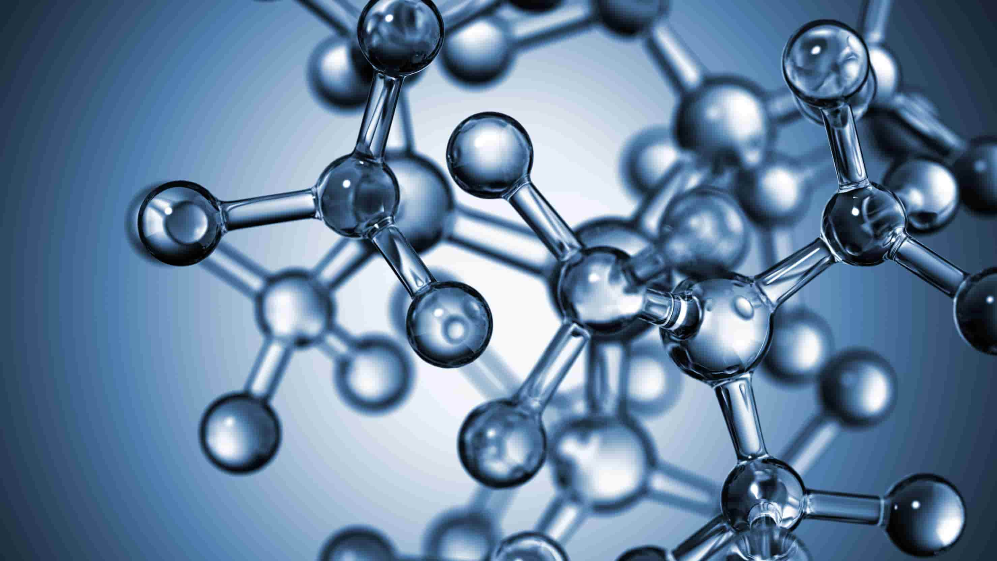
Applications
1. Bone Density Analysis
2. Quantifying tumor cell sizes for grading
3. Measuring lesion cell sizes
4. Blood Cell Analysis
5. Quantitative analysis of tissue microstructures
6. Identifying and quantifying microorganisms aids in diagnosing infectious diseases
7. Analyzing drug particle sizes optimizes drug formulations for enhanced therapeutic efficacy.

Slide 12
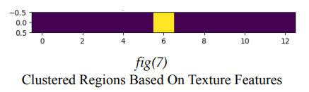
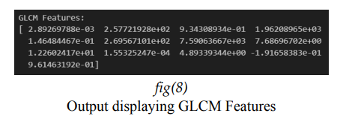
Results and Discussion
The recommended particle characterization approach improves visibility and segmentation, and enhances the visualization of size distribution patterns in a three-dimensional scatter plot.
Texture analysis using GLCM features enhances the ability to differentiate between particles based on their textural properties and employs GLCM-based KMeans clustering to detect plausible heterogeneities in the image.

Slide 13
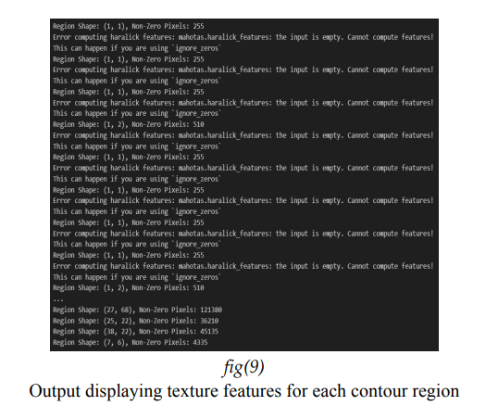
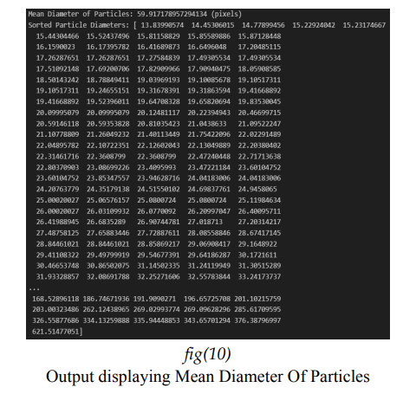
Results and Discussion
Morphological image processing theories by Sciaini and Fritsch are utilized to identify contours on edge-detected images, with subsequent texture analysis enabling a deeper understanding of the spatial structure of the data within each contour area.
Quantitative analysis utilizes a violin plot to visually represent particle diameters and mean diameter, complemented by modern technologies like edge detection and GLCM-based clustering to further enhance the inquiry.

Slide 14

1. Explore machine learning algorithms for automated particle categorization to enhance study efficiency.
2. Extend the system to handle three-dimensional data, enabling a more comprehensive exploration of particle interactions and structures.
3. Investigate state-of-the-art classification approaches for improved efficacy and scalability in particle identification and categorization.
Our integrated image processing and analysis approach successfully provides precise characterizations of microscopic particles, showcasing efficacy in format conversion, cropping, and pipeline processing. The results, including 3D scatter plots and texture analysis, affirm the precision and clarity achieved in understanding particle characteristics.
Conclusion
&
Future work
Reference :
Rosebrock
A. Mishra and T. Pathak, “Estimation of grain size distribution of frictionstir welded
joint by using machine learning approach,” ADCAIJ: Advancesin Distributed
Computing and Artificial Intelligence Journal 10, 99–110(2021)

Slide 15
